Slide 1


1
What is Power BI?
Power BI is a Business Intelligence & Data Visualization tool that convert data from various data source into interactive dashboard and analysis reports.

Slide 2
2
PROJECT :-
Madhav E-Commerce Store

Slide 3

3
OBJECTIVE :-
Owner of Madhav E-Commerce Store wants us to help them create a dashboard to track and analyze their online sales across India

Slide 4
4
Project Learnings :-
Created an interactive dashboard to track and analyze online sales data.
Used complex parameters to drill down in worksheets and customization using filters and slicers.
Created connections, join new tables, and calculations to manipulate data and enable user-driven parameters for visualizations.

Slide 5
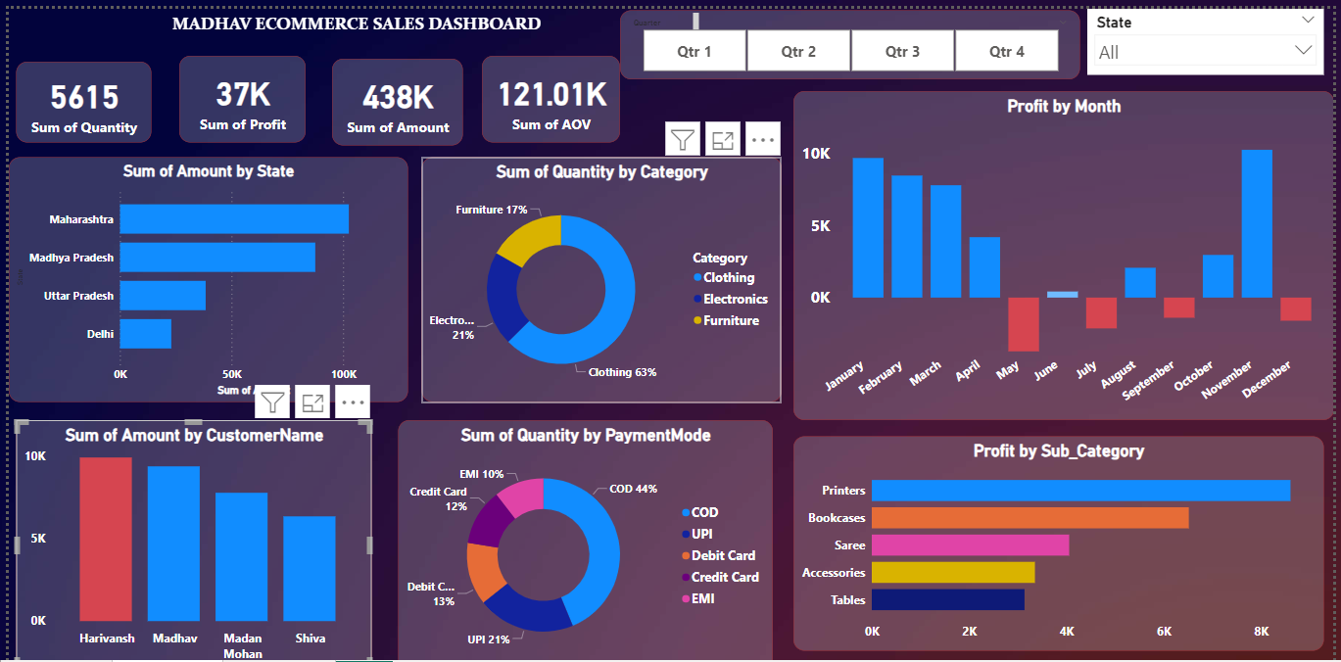
5

Slide 6
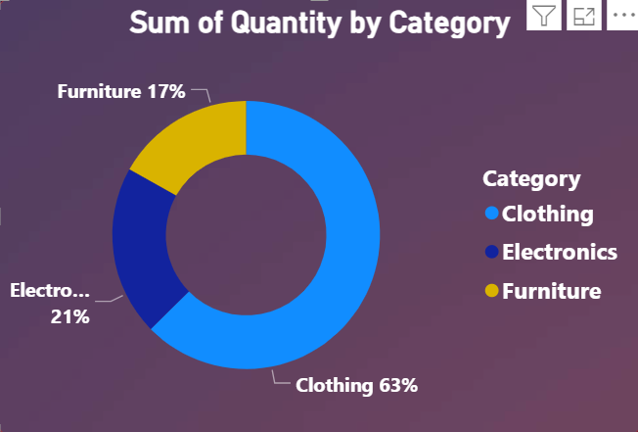
6
Q1. Compare the sum of the amounts with different states?
Most of the customers spent the maximum amounts of money on purchasing products like clothing (63%), Electronics (21%) and furniture (17%) (Printers, Bookcases, Saree, etc).

Slide 7
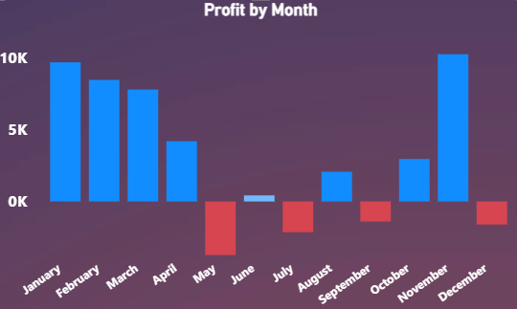
7
Q2. Which person spent the maximum amount of money to buy products?
The store generates the maximum profits from the months January to April and December.

Slide 8
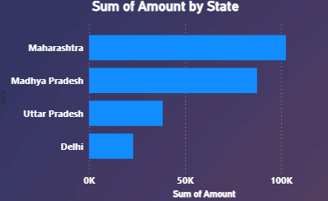
8
Q3. Which category of product customer orders the most (Clothing, Electronics and Furniture)?
The states of Maharashtra, Madhya Pradesh and Uttar Pradesh are the top 3 product buyers.

Slide 9
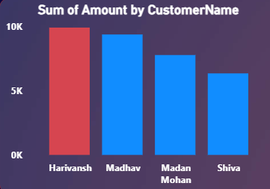
9
Q4. What kind of payment mode customer uses the most while purchasing products?
The customers Harivansh, Madhav and Madan Mohan are the top 3 product buyers.

Slide 10
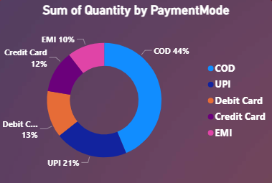
10
Q5. Which months of the year Madhav Store generate the maximum profit and minimum profit?
Generally, the customers use the Cash on Delivery (44%) and UPI (21%) mode of Payment.

Slide 11
11
Thank
You

